Slide 1
Scientific publication review:
Development and Validation of a Deep Learning System for Staging Liver Fibrosis by Using Contrast Agent–enhanced CT Images in the Liver
By Kyu Juin Choi and al.
Juan Pablo Garcia Martinez

Slide 2
Index
Purpose and Material
Method
Result
Conclusion
Review and analysis

Slide 3
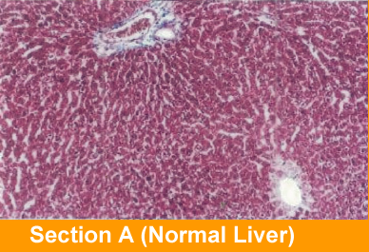
Purpose: DLS for staging liver fibrosis from CT images
Comparison of methods:
Deed Learning System
Alternative methods
Eligible: 7889
Train Dataset: 7461
Patients: 12535
Subset: 421
Radiologist’s assessment x4
Aminotransfererase to platerel ratio index (APRI)
Fibrosis-4 index
Test Dataset: 891
4:1 Train/Test Ratio
Blood Test
Labelled
Data
Labelled data obtain via liver pathologic examination by using hematoxylin-eosin
and Masson Trichroeme staining.

Slide 4
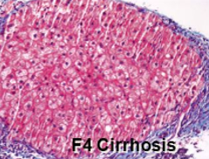
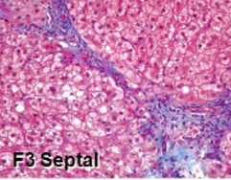
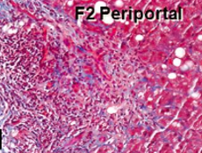
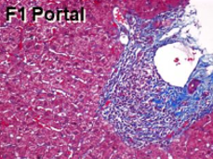
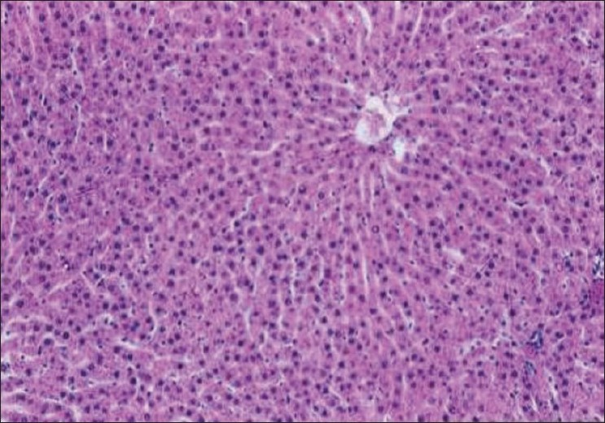
Labels: Meta-analysis of Histological Data
in Viral Hepatitis (METAVIR)
F4 = cirrhosis.
F3 = septal fibrosis
F2 = periportal fibrosis
F1 = portal fibrosis
F0 = No Fibrosis

Slide 5
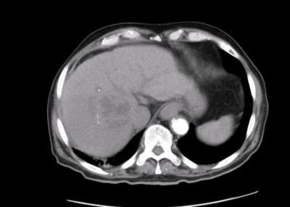
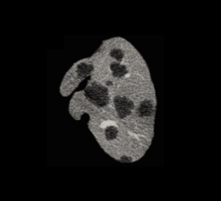
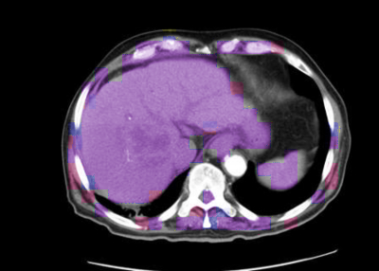
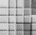
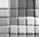
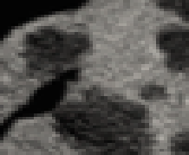
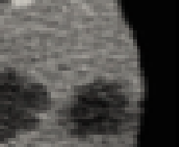
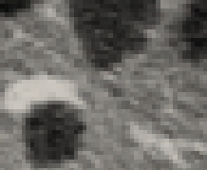
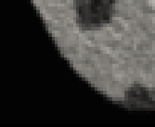
Pipeline
CNN: Convolutional Neural Network
Liver Segmentation algorithm
+
Convolutional Neural Network
Liver Segmentation algorithm
Feature maps
Feature maps
Softmax
Input
Feature maps
F0
F1
F2
F3
F4
Output
Subsampling
Fully Connected
Subsampling
Convolutions
Layers x 15
Convolutions
OUTPUTS: F0 = no fibrosis, F1 = portal fibrosis, F2 = periportal fibrosis, F3 = septal fibrosis, F4 = cirrhosis.

Slide 6
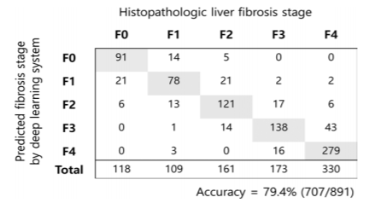
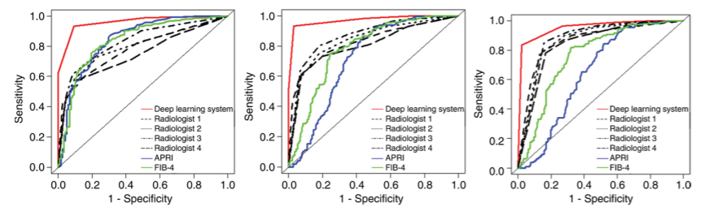
Results
Confusion Matrix
1.- Clear tendency to the + diagonal of the CM
2.- Not many extreme values
3.- Accuracy = 79.4%
4.- DLS performs better than alternative methods
ROC/AUROC
Significant Fibrosis: ACC=94.1%
Advance Fibrosis: ACC=95.0%
Cirrhosis: ACC=92.1%
OUTPUTS: F0 = no fibrosis, F1 = portal fibrosis, F2 = periportal fibrosis, F3 = septal fibrosis, F4 = cirrhosis.
Significant Fibrosis (F2-F4); Advanced Fibrosis (F3-F4); Cirrhosis (F4)

Slide 7
Review and analysis

Slide 8
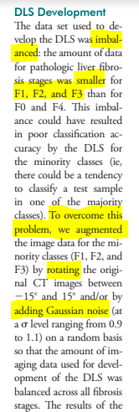
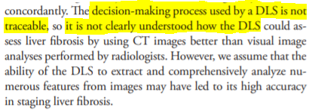
Notes
Imbalanced data sorted with data augmentation:
Rotation (15◦)
Gaussian Noise
Page 695: Discussion
The decision-making process used by a DLS is not traceable.
Page 690: DLS Development

Slide 9
Conclusions (Researcher)
Balance dataset with classic Data Augmentation:
for each input image, we generate a duplicate that is transformed. The main inconvenience of using this method is that local patterns can be learnt by our classification method.
DLS not traceable:
Black box effect in deep learning is a common issue. Innumerable calculations are made within the many hidden interior layers of nodes.
Alternative
Generative Adversarial Network
Link 1: https://youtu.be/8qb9XKviMz4
Link 2: https://youtu.be/S7cANCciT20
Generate more dynamic synthetic data for data augmentation
Track convolutional neural network as per deconvolution.
Note: loss function visual representation to track learning path of the CNN

Slide 10
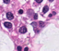

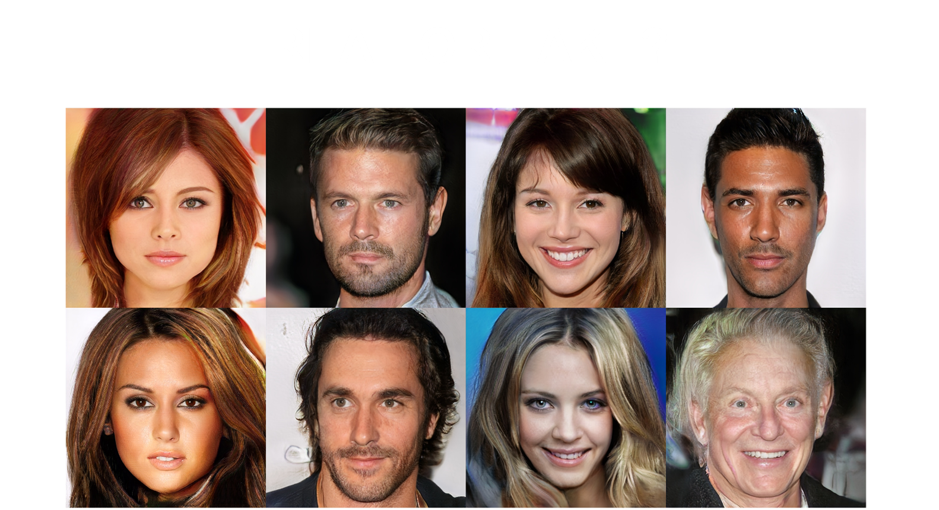
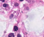
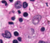
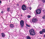
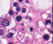
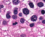
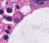
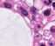

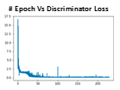
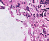
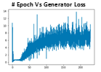
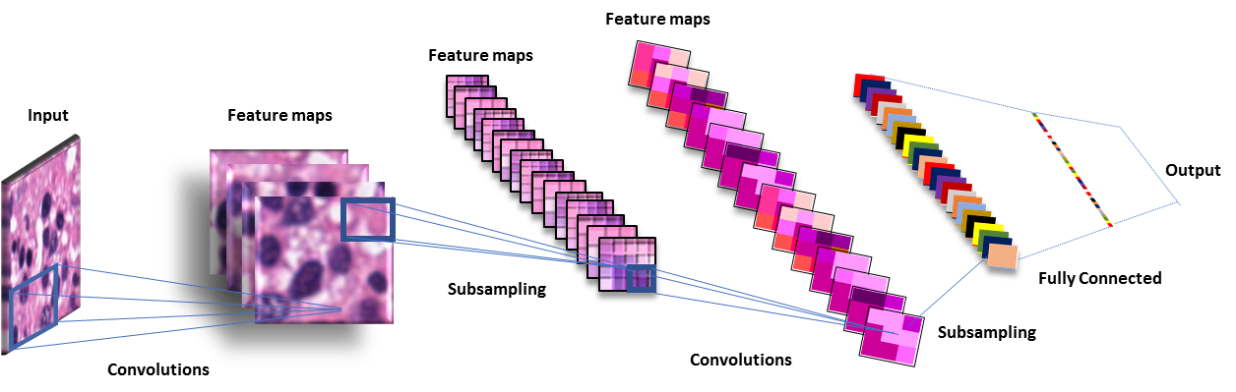
Deep Convolutional Generative adversarial network
Train Dataset
Train the size of the batches
Calculate
Loss for D and G
Random Noise
D Discriminator
G Generator
Convolutional neural network (Dcgan)
Generator
Discriminator
Notes:
Generator is a deconvolutional Neural Network. From a random noise the code will try to replicate the sample patterns in the bets way possible, while the discriminator is a classical CNN trained with or train data. The generator will try to trick the discriminator to make believe the generated images are actually real.

Slide 11
Highlights
The research shows how DLS performs better than other classic methods and humans.
There is no comparison between the DLS and other Images classification methods such as t-SNE or NNM
The dataset was imbalanced and data augmentation was applied for F1, F2 and F3.
Data Augmentation could be applied using DCGAN to make it more dynamic and accurate.
The DLS was not traceable (black Box)
The progression of the Loss value by epoch or LR could be included in the report
DCGANs help us to understand how well the model is extracting the features
Features exploration.
Fully automated diagnosis tool with two stages: 1.- Segmentation of the liver area 2.- Classification
More data regarding the liver segmentation would be helpful to analyse this publication.
Good data management to keep a validated and consolidated source of data for the experiment.

Slide 12
Recommendations
Apply a more selective method as Mask-RCNN.
Apply some texture analysis.
Use DCGANs to increase the number of samples and hence improve performance.
Include more information of the DL model.
Complete dataset with public dataset where possible.
Try different CNN architectures for comparison.
Compare the CNN with other classification methods.
Confusion matrix for alternative methods
Publications and books:
GAN-based synthetic medical image augmentation for increased CNN performance in liver lesion classification. Heindl el al
https://www.sciencedirect.com/science/article/pii/S0925231218310749
- Microenvironmental niche divergence shapes BRCA1-dysregulated ovarian cancer morphological plasticity. Frid-Adar et al
https://www.nature.com/articles/s41467-018-06130-3
Hands-On Machine Learning With Scikit-Learn & Tensorflow. A.Geron

Slide 13
